Slide 1

Building an ERP System For Student Entrepreneurs at Meinders School of Business
From:
Satya
Sai Vineesh
Sreeja

Slide 2
Introduction of the Project
The project aims to develop a customized ERP (Enterprise Resource Planning) platform tailored specifically for student entrepreneurs at Meinders School of Business. This platform will streamline and integrate core business operations, empowering students to manage their startups effectively.
To provide an all-in-one solution that enhances the business management experience for student entrepreneurs.
Key features include a built-in financial assistant that offers guidance on business operations, financial management, and even provides stock market tips to help students make informed decisions.
The platform is designed to simplify complex business processes, allowing students to focus on growth and innovation.

Slide 3
Project Objectives
Develop a Customized ERP Platform: Create a tailored ERP solution for student entrepreneurs at Meinders School of Business, focused on the unique needs of startup management.
Integrate Business Operations: Provide a seamless, centralized system that integrates core business functions such as finance, inventory, customer management, and human resources.
Enhance Decision-Making: Offer a built-in financial assistant feature that guides users in business operations, helping with budgeting, expense tracking, and cash flow management.
Provide Stock Market Insights: Include a feature that delivers stock market tips and financial insights, empowering students to make informed investment decisions.
Support Entrepreneurial Growth: Equip students with the necessary tools to efficiently manage their startups, reduce manual processes, and focus on business expansion and innovation.

Slide 4
Why This App Suite?
Current Challenges for Student Entrepreneurs:
Difficulty managing finances and operations.
Lack of personalized financial insights and advice.
Time-consuming manual management of business activities.
Opportunity:
A smart, easy-to-use app suite can streamline business tasks, provide real-time data insights, and offer investment advice.

Slide 5
Key Features of the App Suite
Customizable ERP System:
Tailored dashboards and tools for each student entrepreneur.
Integrates business processes: accounting, inventory management, and project tracking.
Financial Assistant:
Personalized financial management: budgeting, tracking, and reporting.
Stock Tips & Investment Insights:
Algorithm-based stock recommendations.
Real-time stock market data and forecasts.

Slide 6
Key Functionalities
Financial Management:
Automated expense tracking, invoicing, and revenue management.
Real-time profit/loss analysis.
Stock Tips Feature:
AI-driven recommendations based on market analysis and trends.
Educational tools on stock market fundamentals.
Customizable User Interface:
Personalized dashboard and reports.
Easy setup for different types of business models (e.g., product-based, service-based).

Slide 7
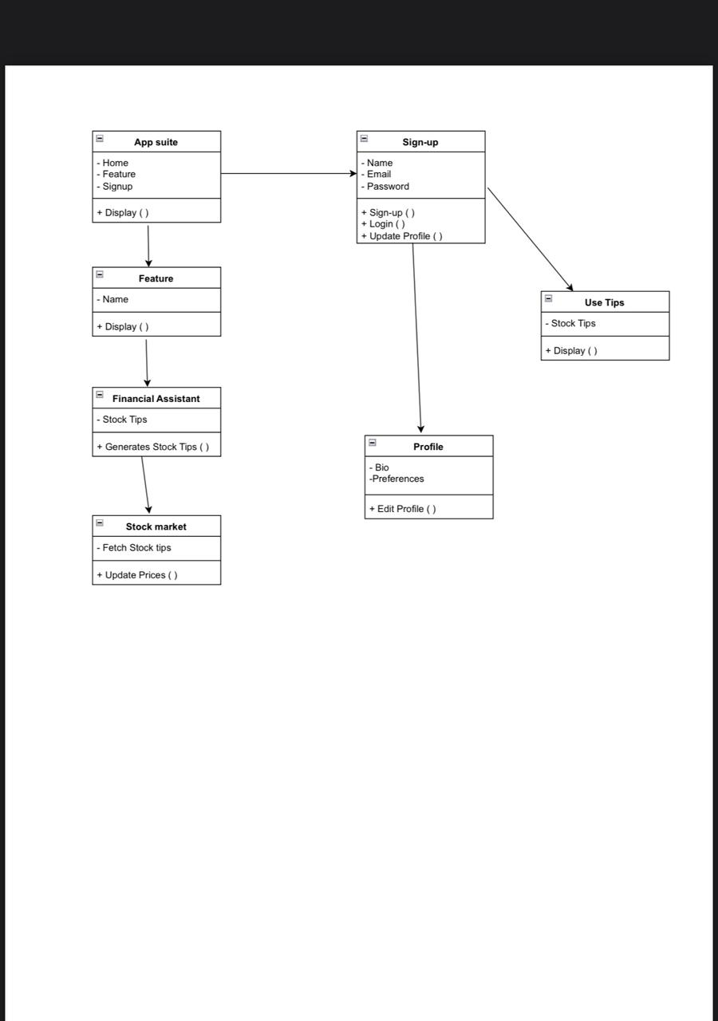
UML Diagram
Class Diagram :

Slide 8
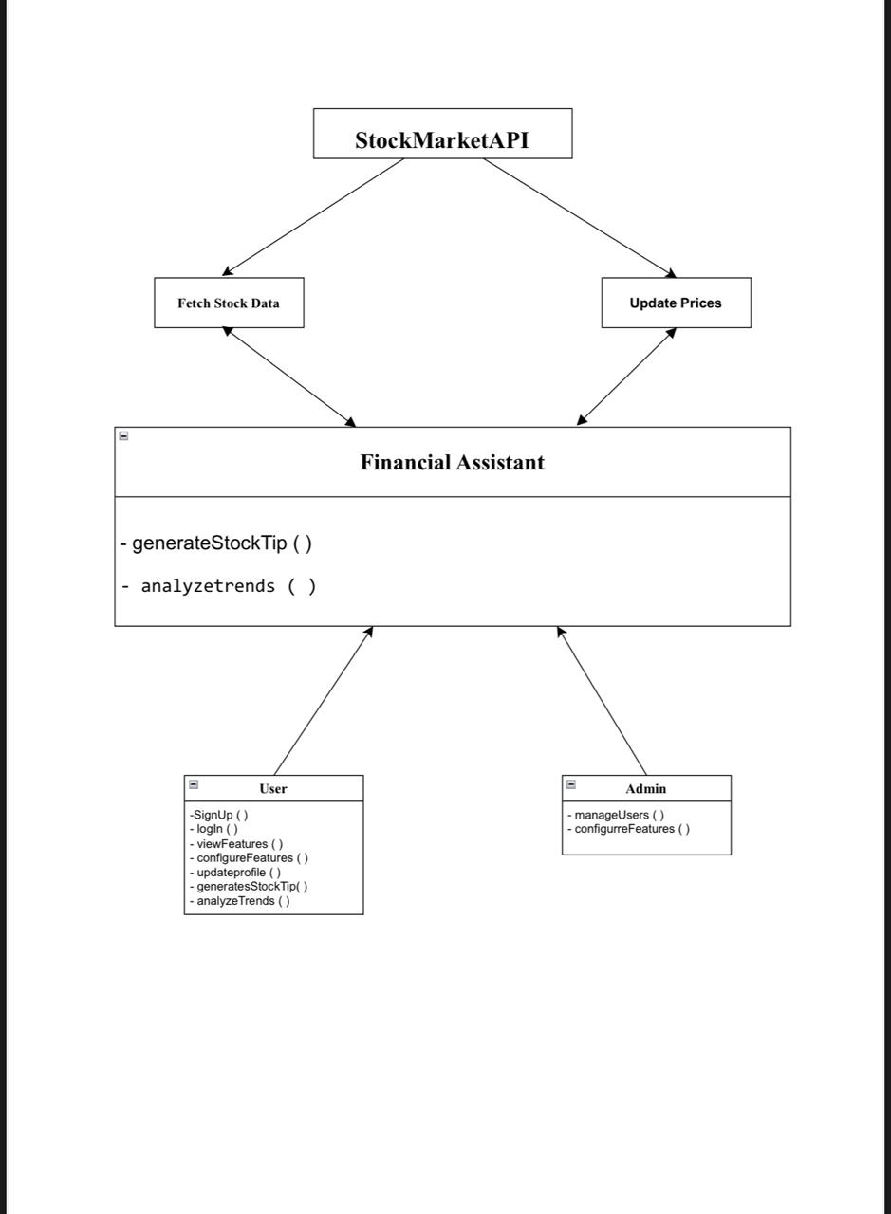
Use Case Diagram:

Slide 9
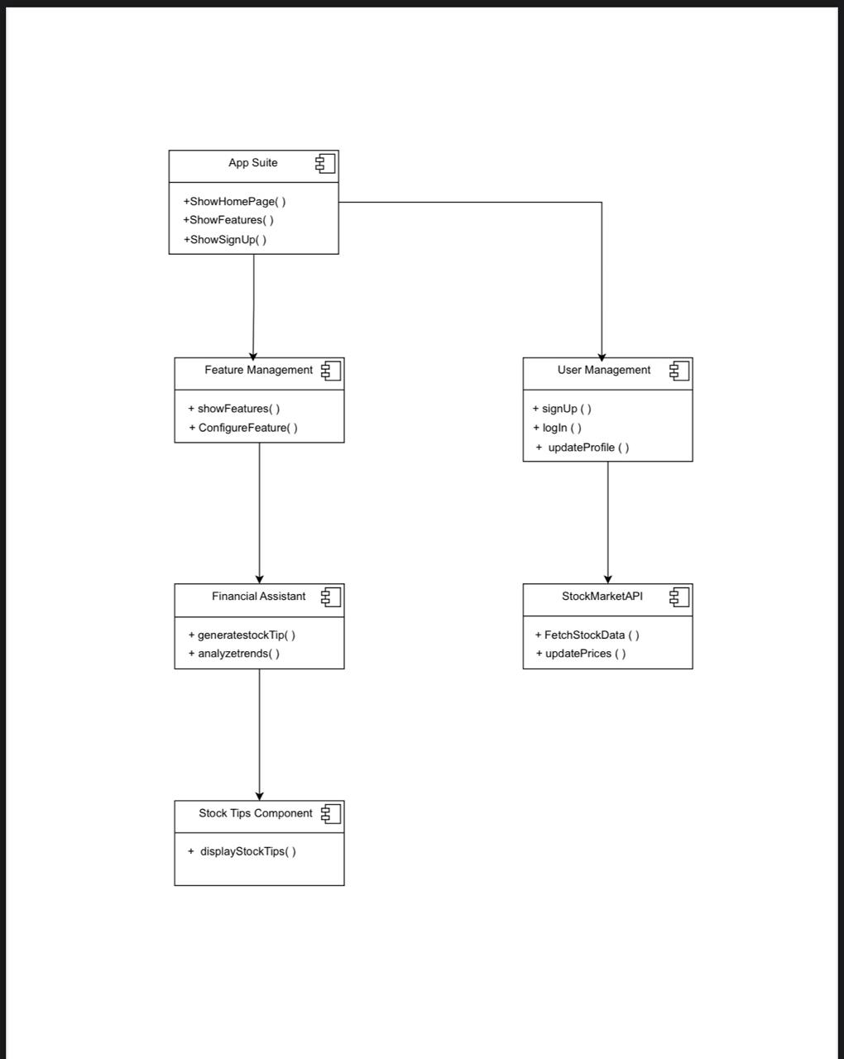
Component Diagram:

Slide 10
Benefits for Student Entrepreneurs
Time Efficiency: Automates and streamlines business tasks.
Financial Control: Provides real-time insights into finances and investments.
Empowerment: Equips students with practical financial skills and stock market knowledge.
Scalability: Grows with the entrepreneur’s business and can be customized for future needs.

Slide 11
Technology Stack
Frontend: React Native for cross-platform mobile development.
Backend: Node.js with Express for scalable server-side logic.
Database: PostgreSQL for relational data management.
Stock Market Integration: APIs like Alpha Vantage for stock data.
AI Component: Machine learning algorithms to provide stock tips.

Slide 12
Implementation Timeline
Phase 1: Research & Design (Week 1-2):
User requirements gathering.
Wireframes and prototypes.
Phase 2: Development (Week 3):
Backend & database setup.
Financial assistant algorithm and stock tip integration.
Phase 3: Testing & Feedback (Week 4):
Pilot testing with select students.
Refinement based on user feedback.
Phase 4: Launch (Week 5):
Official rollout to all student entrepreneurs.
Ongoing updates and maintenance.

Slide 13
Potential Challenges
User Adoption: Encouraging students to actively use the platform.
Stock Tip Accuracy: Ensuring the financial assistant provides reliable, actionable insights.
Data Security: Protecting sensitive financial and business data.

Slide 14
Conclusion
Vision: Equip Meinders School of Business students with powerful tools to manage their ventures effectively and intelligently.
Impact: Enhance their entrepreneurial success through real-time financial insights, streamlined operations, and investment opportunities.

Slide 15
THANK YOU

